Slide 1

Synthetic Biology Open Language: Data Model version 3
Presenter: Gonzalo Vidal

Slide 2
Agenda
Introduction to SBOL
Hands on creation of a transcriptional unit
Demonstration of SBOL for assembly planning
Demonstration of SBOL for simulations

Slide 3
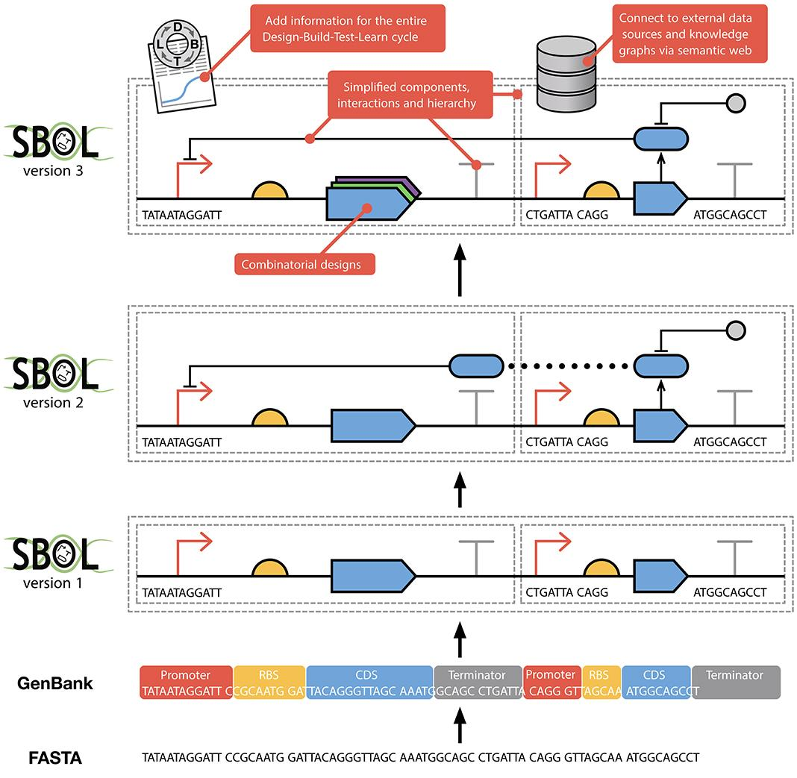
SBOL development
Fasta: Structural information.
GenBank: Structural and functional information.
SBOL: Standardized structural and functional information.

Slide 4
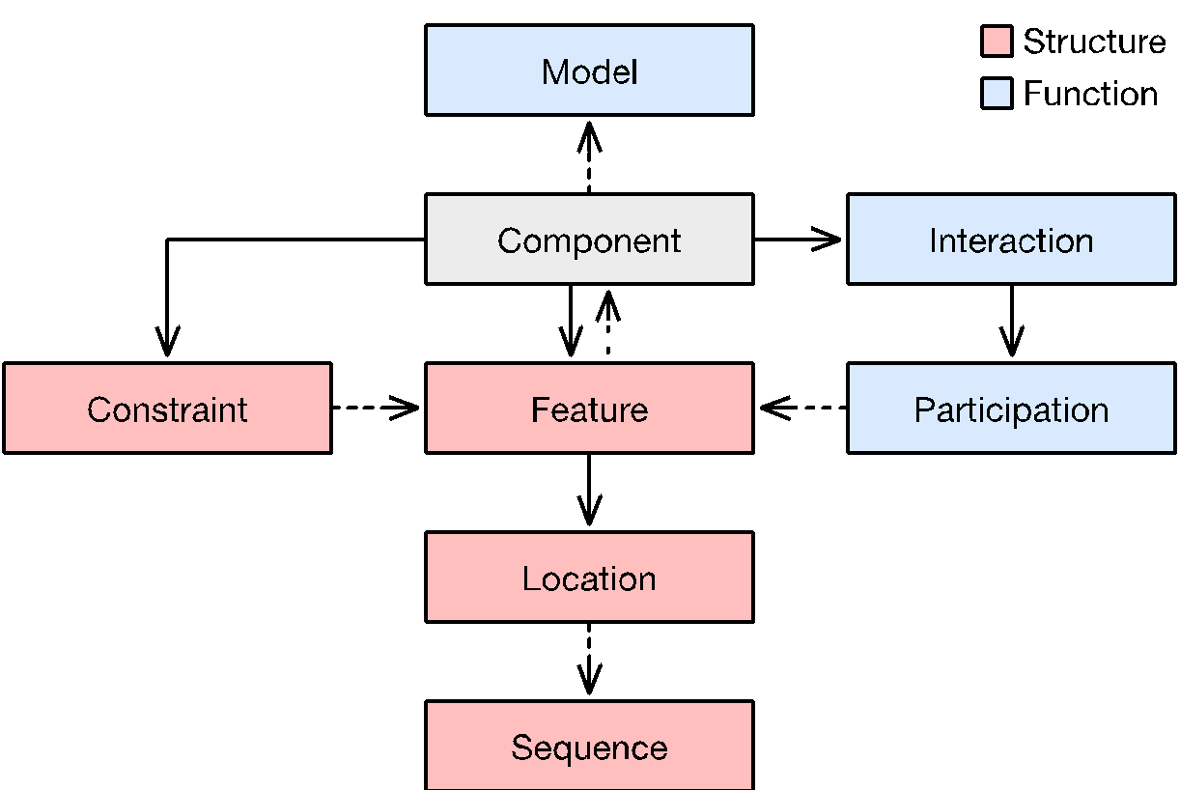
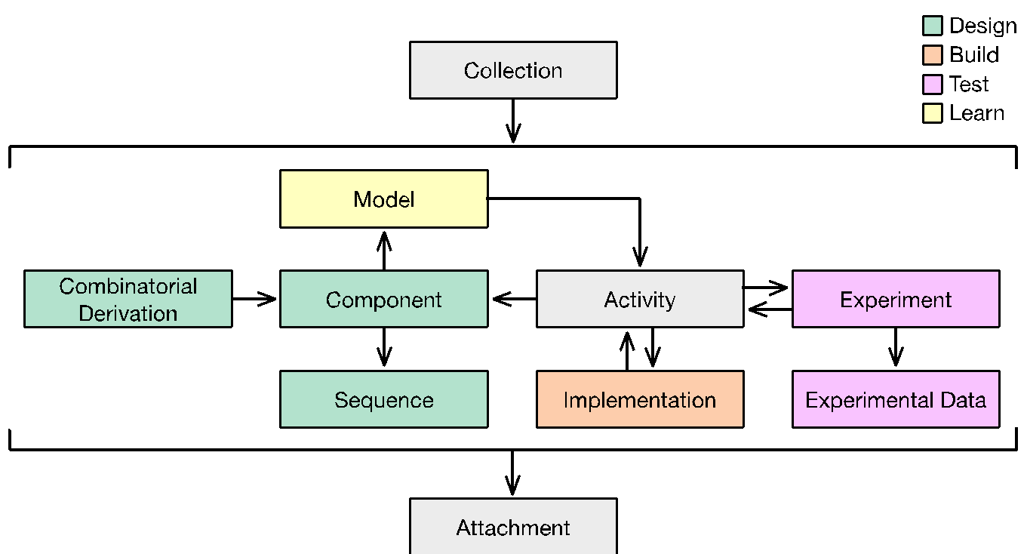
SBOL data model version 3
Core Design Classes
Complete Data Model

Slide 5
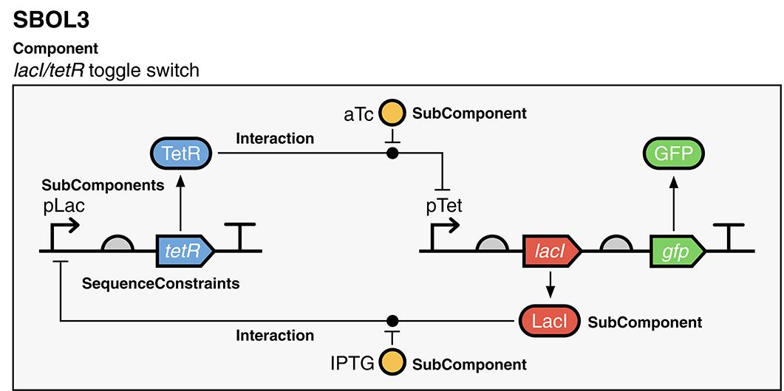
Example

Slide 6
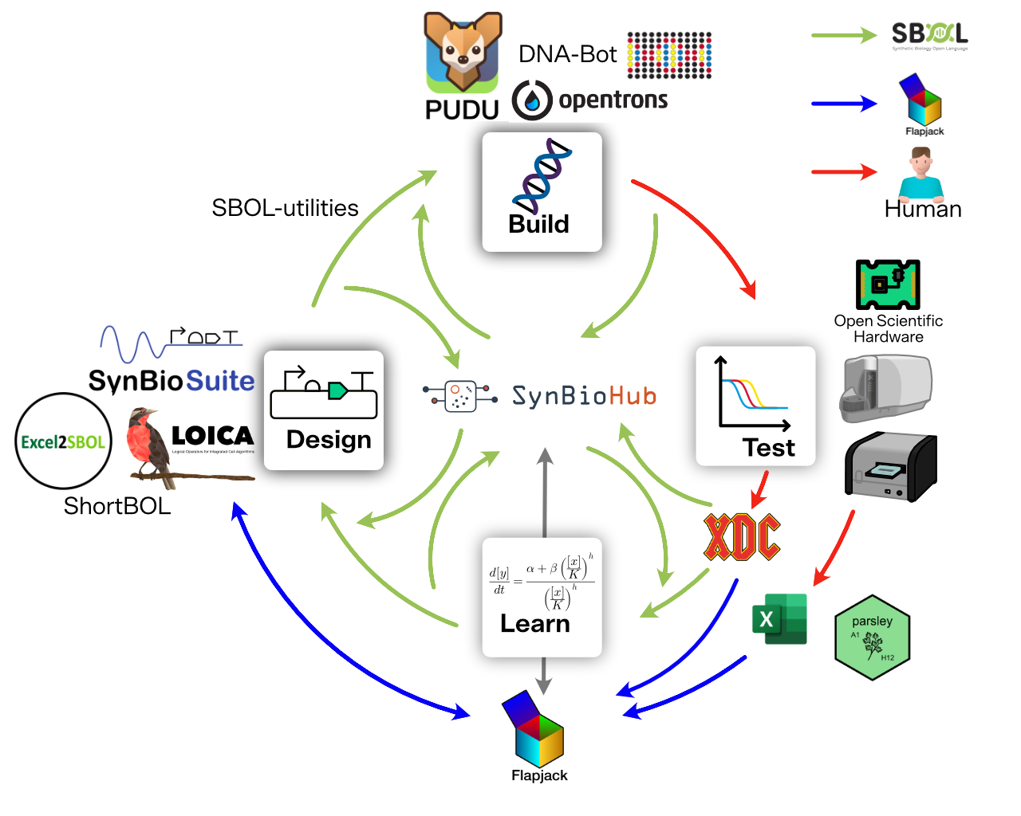
SBOL captures DBTL stages metadata
Interface between stages
Modular DBTL workflows
Collaboration in distributed DBTL workflows

Slide 7
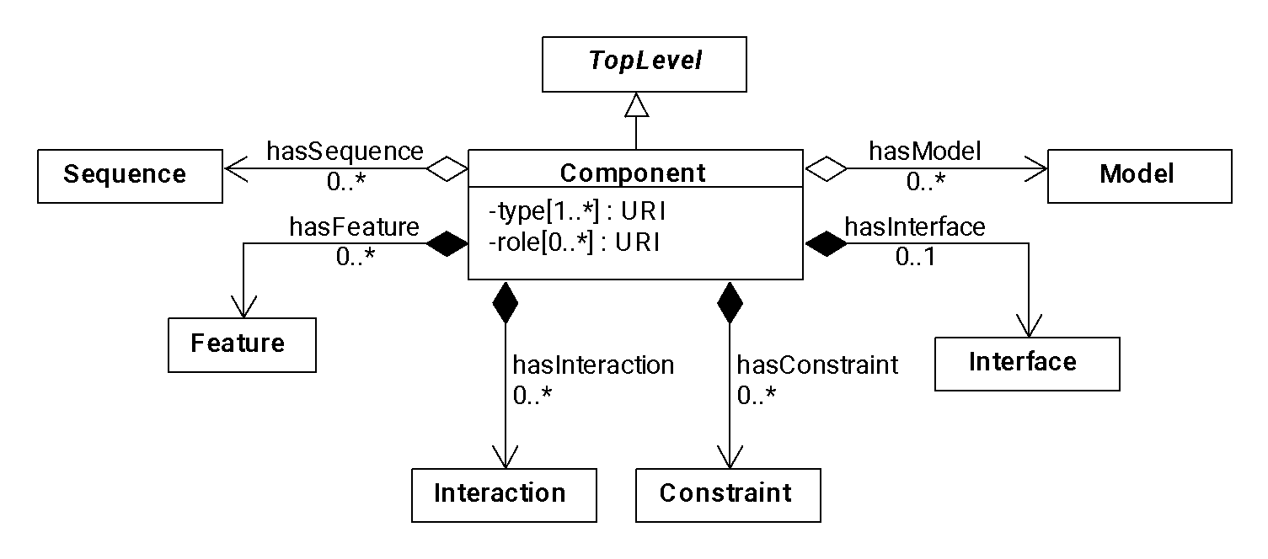
Component: the root of every design
Nucleic acid sequence,
Amino acid sequence,
SMILES, etc…
Pointers to
numerical models
Parts/ SubComponents
Abstractions
Functional
interactions
Topology & identity
A component can be DNA, RNA, protein, a small molecule, a strain of cells, a media recipe, an experimental sample design, …

Slide 8
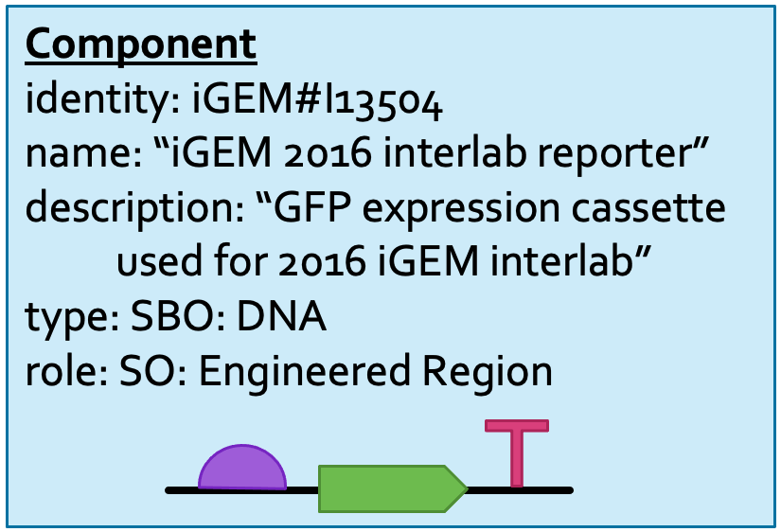
Example: GFP expression cassette

Slide 9
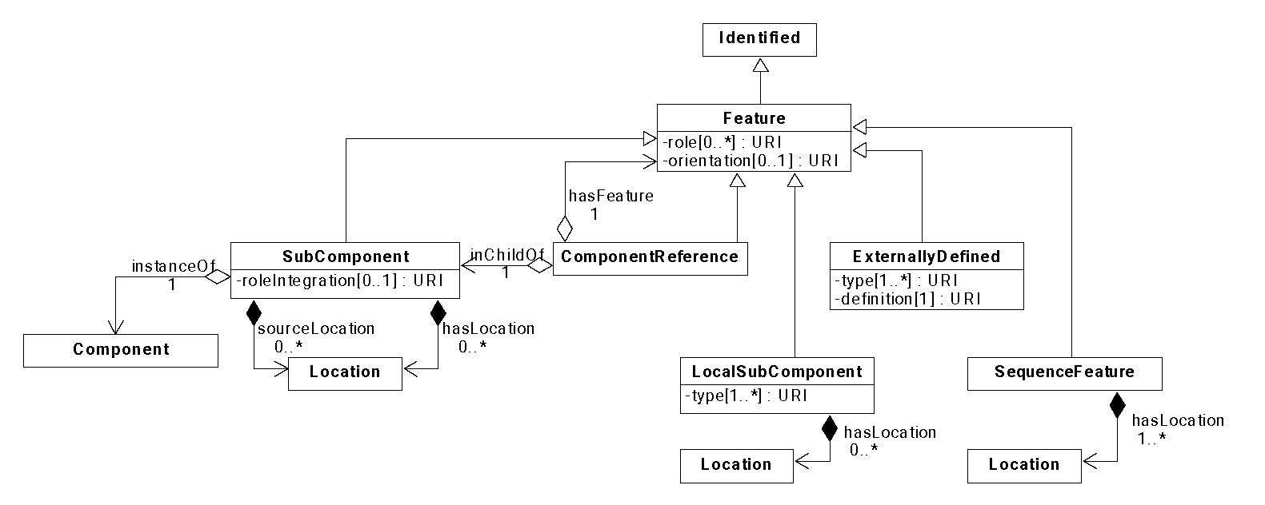
Features: Structural aspects of a component
Pointers to non-SBOL
(e.g., ChEBI, UniProt)
Reusable parts
Pointers inside
SubComponents
Local annotations
(e.g., cut sites, scars)
In-context parts
& placeholders

Slide 10
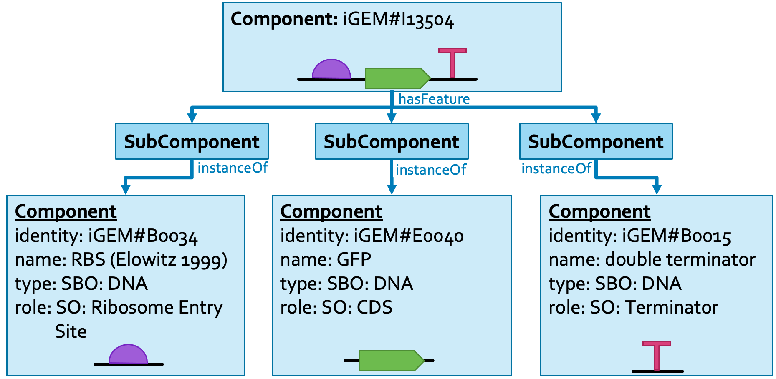
Example: expression cassette parts

Slide 11
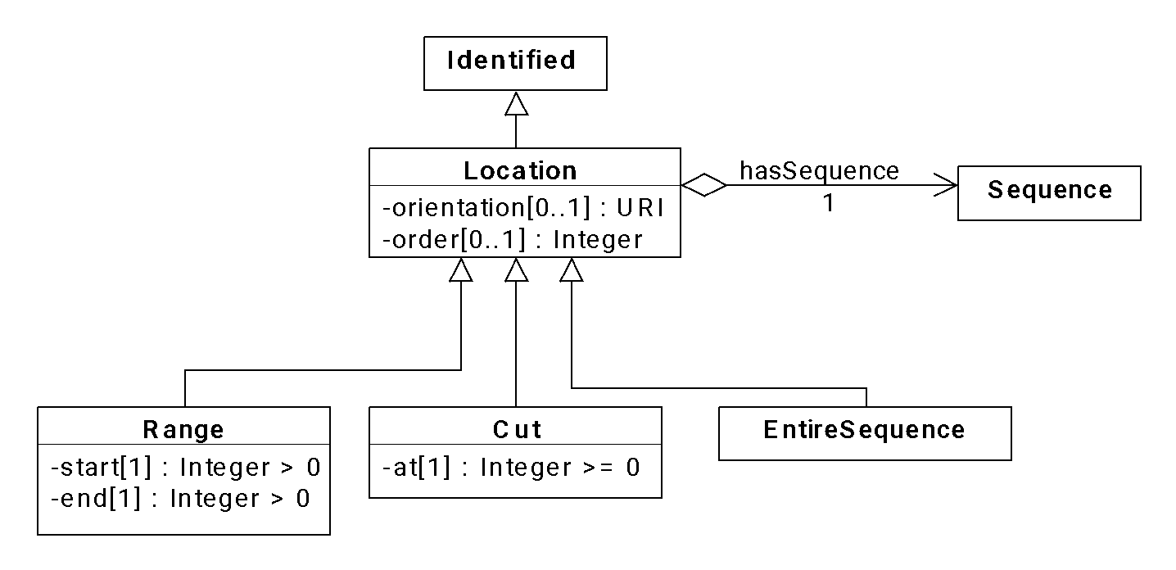
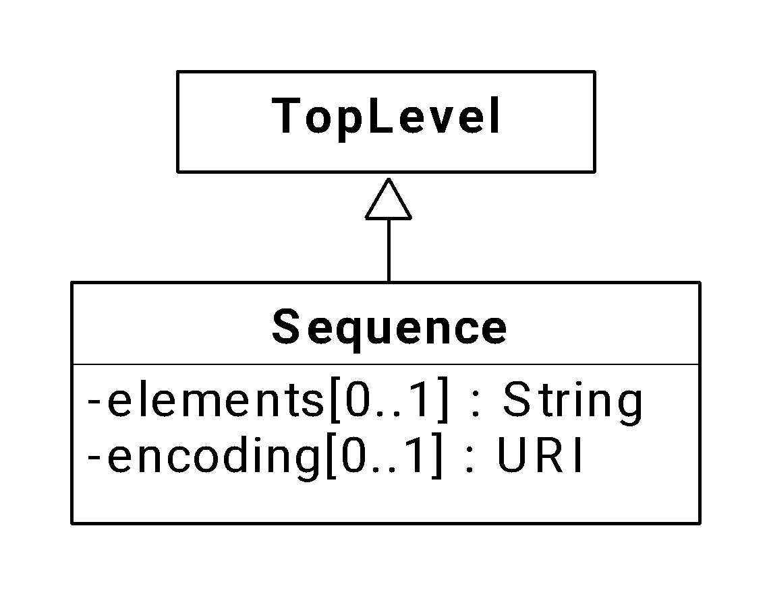
Sequences & Locations
Forward or reverse complement
For introns, insertions,
origin-crossing
IUPAC NA, IUPAC AA,
SMILES, InChI, …
When just connecting
Component & Sequence
Between bases
(e.g., restriction site)
1 or more bases
(e.g., coding sequence)

Slide 12
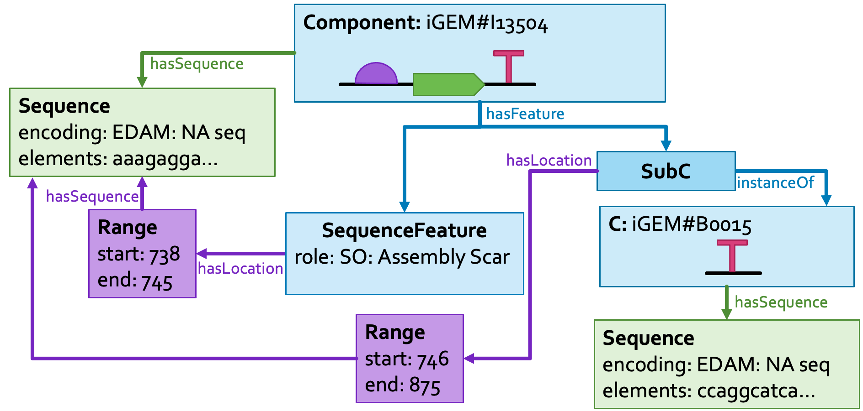
Example: Location of a SubComponent

Slide 13
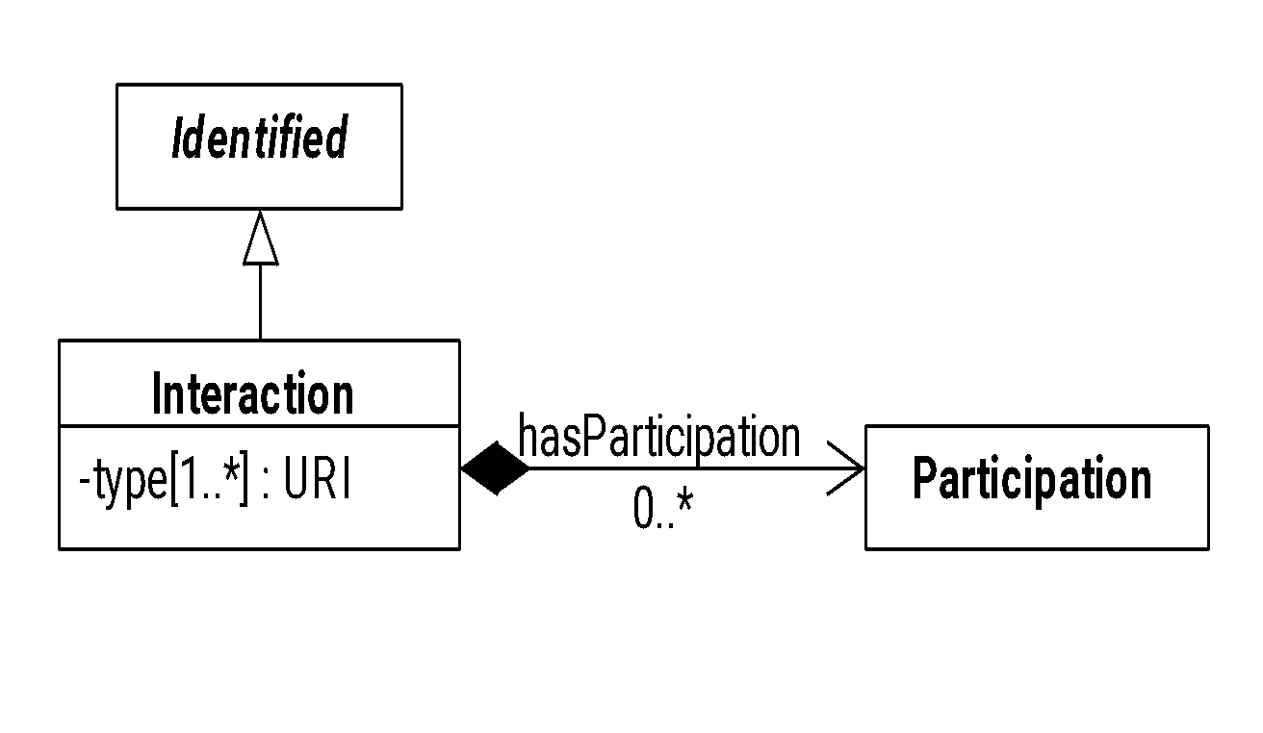
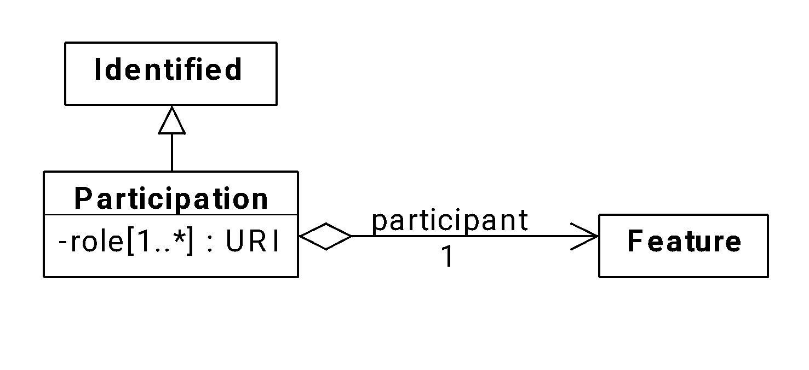
Functional information: Interaction & Participation
e.g., genetic production,
biochemical reaction,
Inhibition, stimulation, …
Template, product,
reactant, inhibitor,
inhibited, …

Slide 14
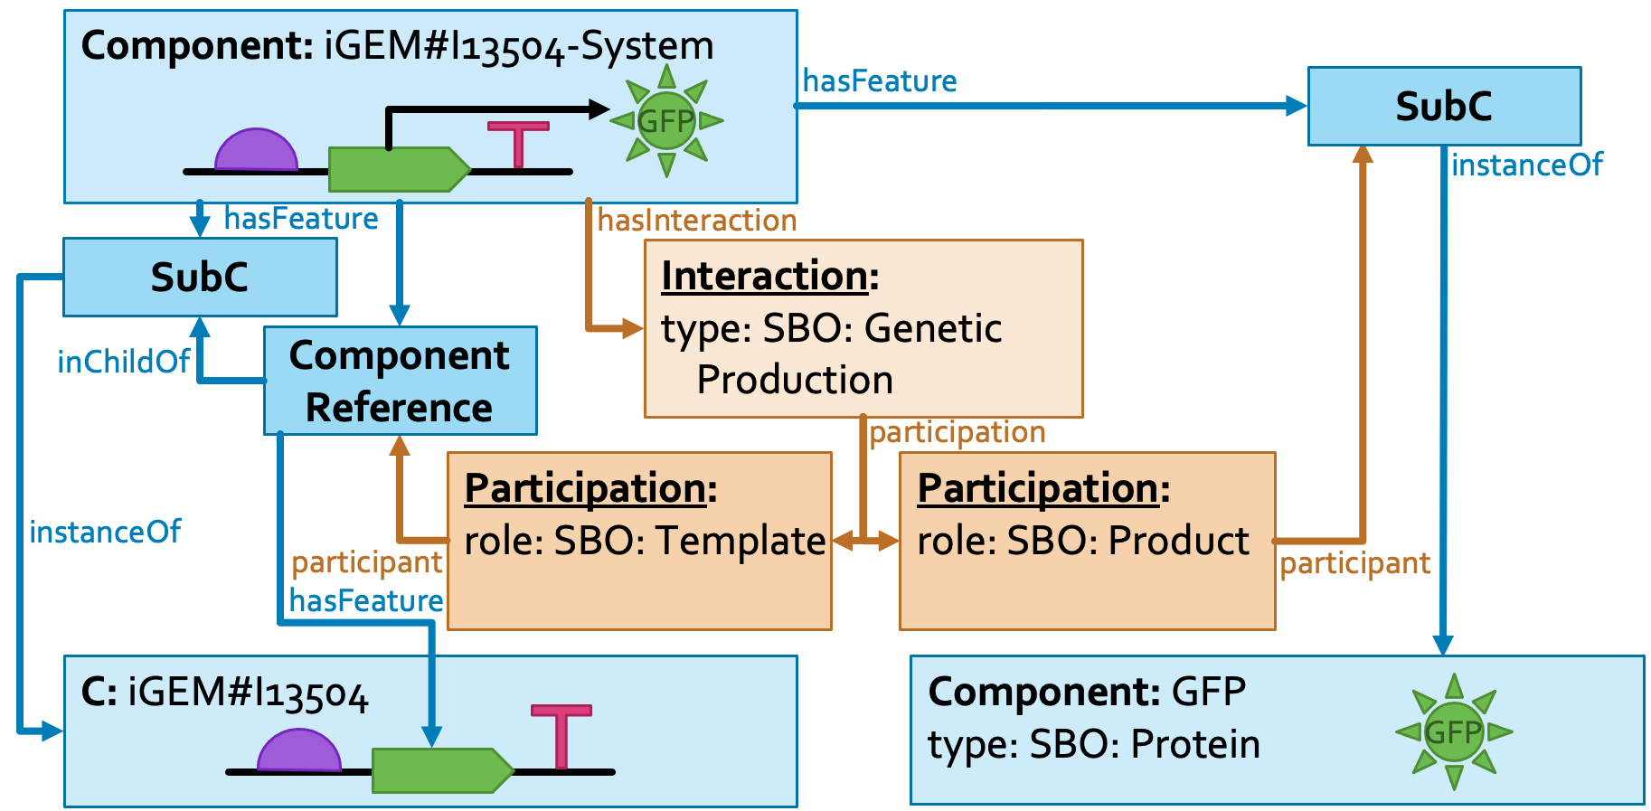
Example: GFP production from expression cassette

Slide 15
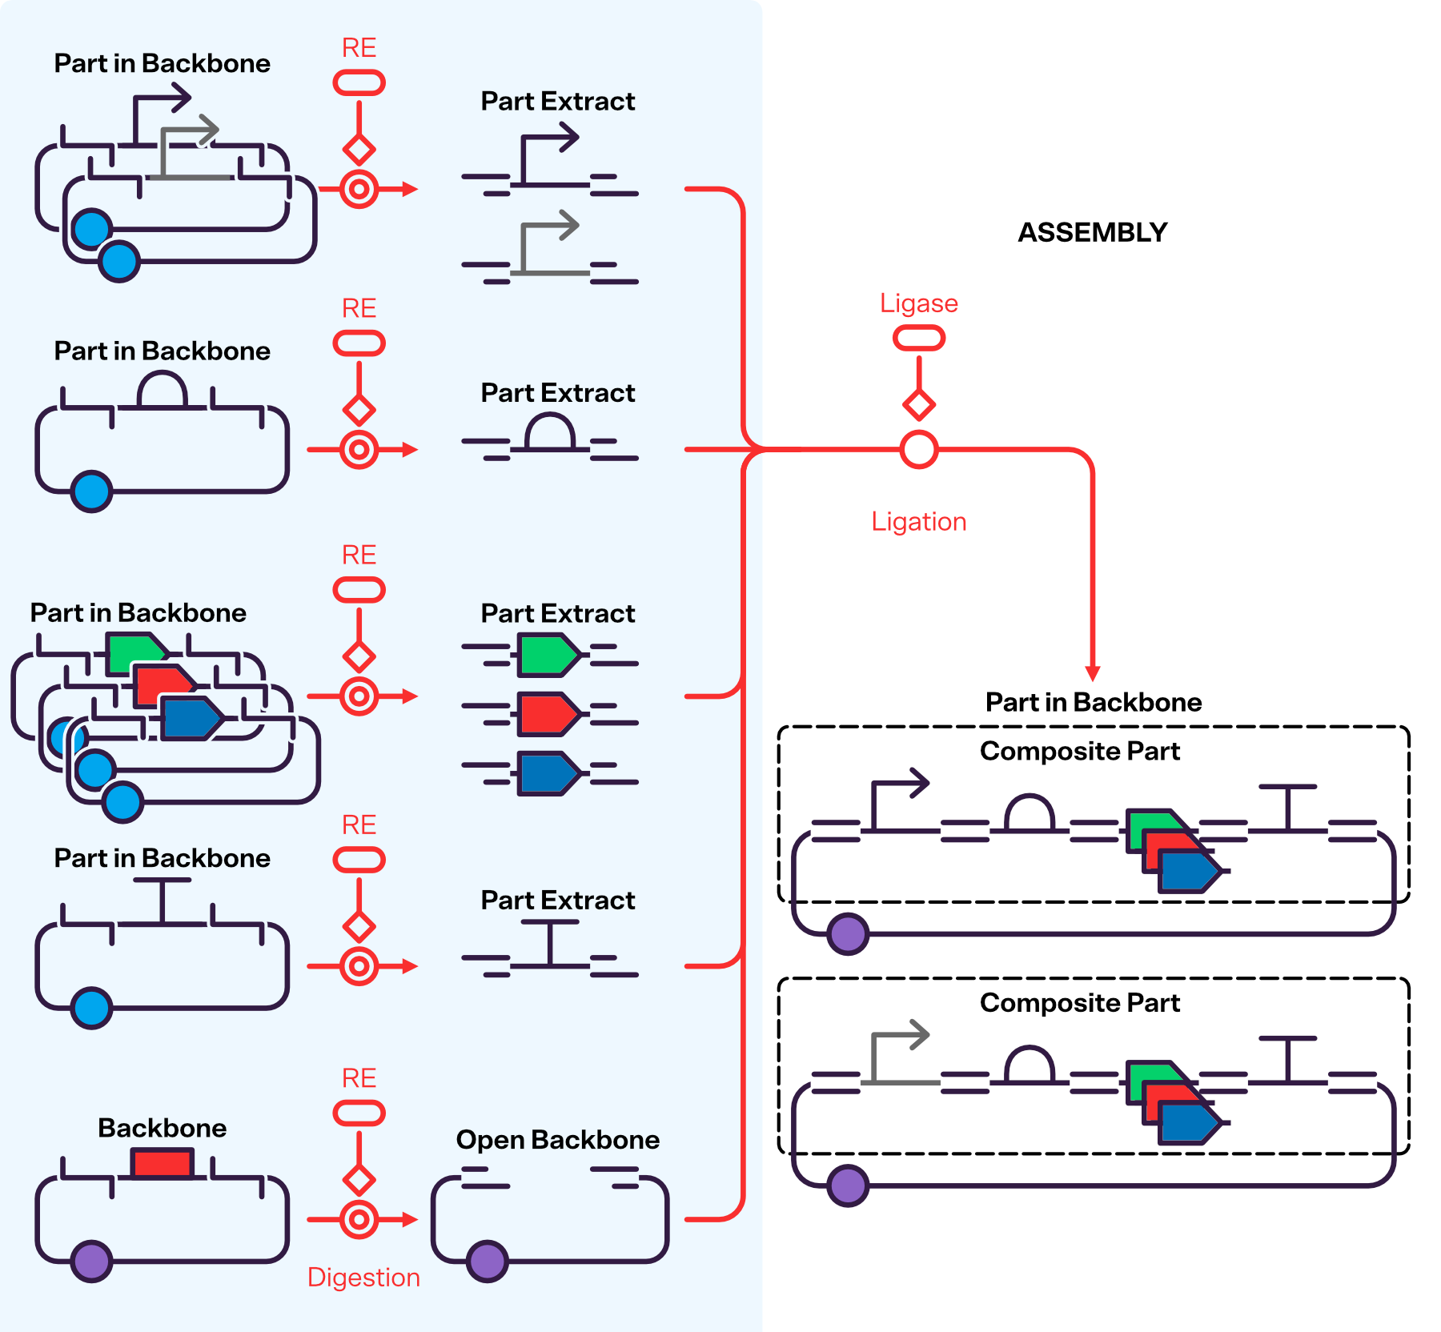
Wetlab example

Slide 16
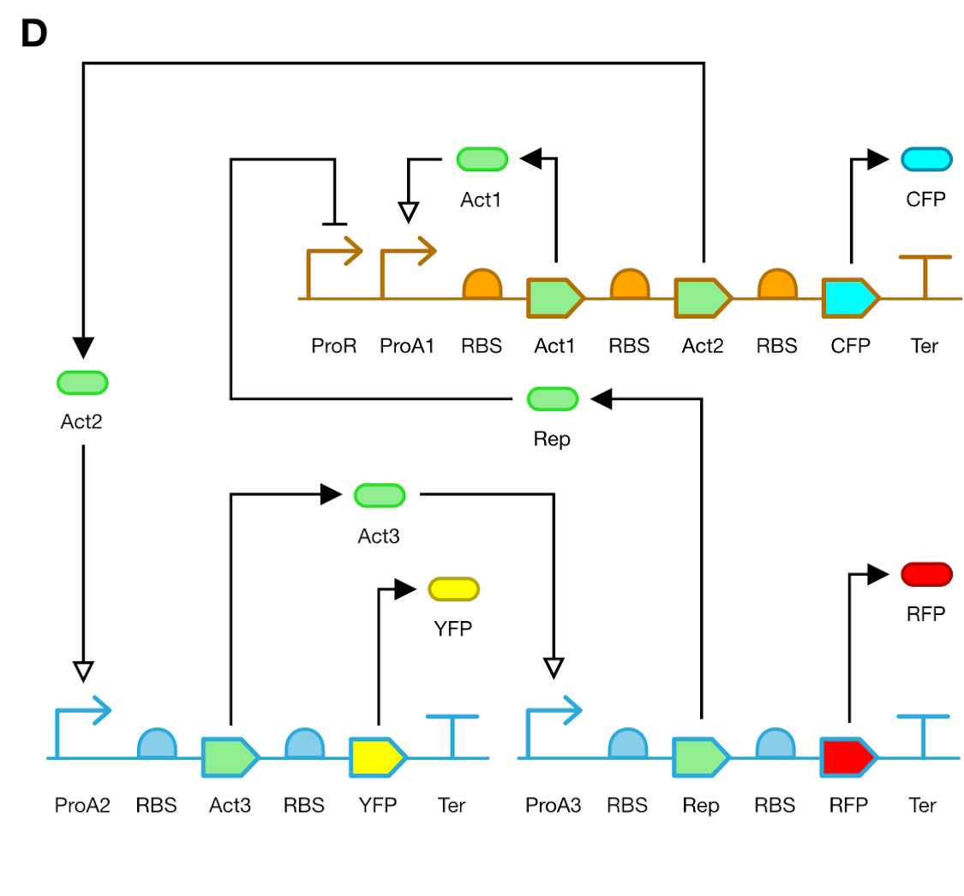
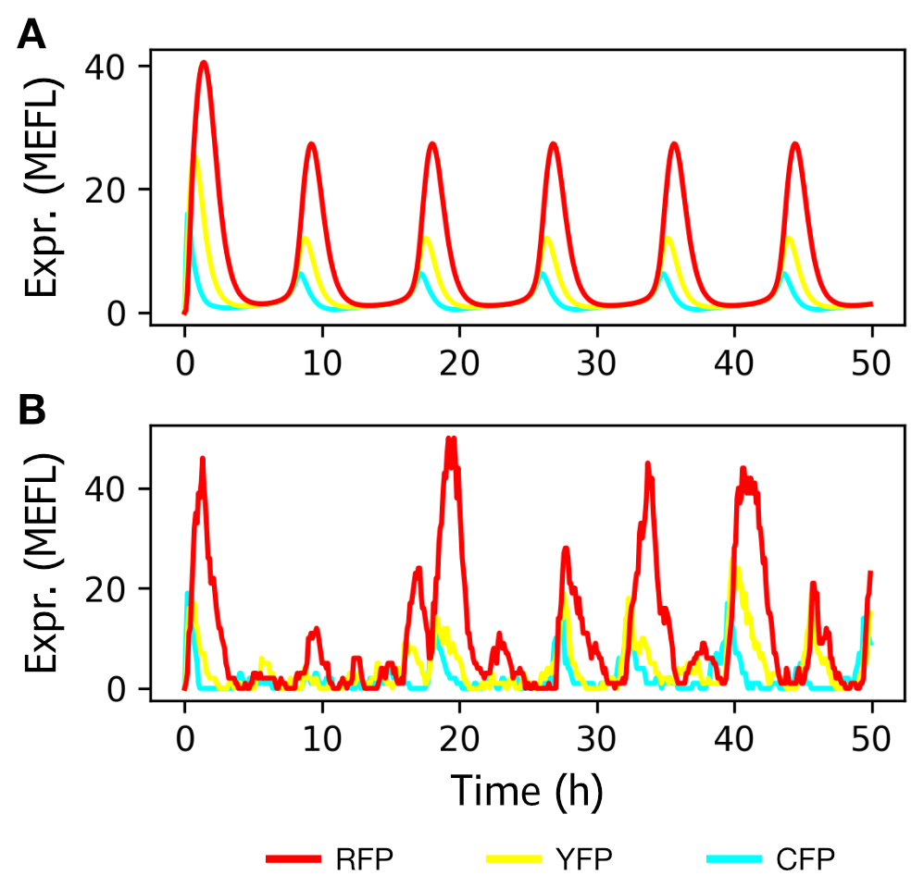
Drylab example

Slide 17
SBH

Slide 18
Resources
Links
github org
webpage
sbol-utilities
pySBOL3-2
Slack channel
emails

Slide 19










Acknowledgements

Slide 20
Hands on exercise
Creating a transcriptional unit that expresses GFP
Code:

